Slide 1
ACE Workshop Spatial and Spatiotemporal Statistics
Rajib Paul, PhD* and Oluwaseun Adeyemi, MBChB, MPH, PhD **
*University of North Carolina at Charlotte
** New York University Langone Health
Emails: Rajib.Paul@charlotte.edu
Oluwaseun.Adeyemi@nyulangone.org

Slide 2
Outline of the Workshop
Basics of Epidemiological Measures and General Introduction to Count and Rate Regressions for Spatial Data
Running Count and Rate Regressions in R/RStudio: Interpretations of Results – Two Breakout Room Sessions
Count/Rate Regressions for spatiotemporal data
Concluding Remark and other extensions

Slide 3
Acknowledgements
This tutorial is prepared as part of our funded research supported by the American Public Health Association in conjunction with the Centers for Disease Control and Prevention on Data Science Demonstration Project for Injury and Trauma Prevention
The Centers for Disease Control and Prevention (CDC)
The National Highway Traffic Safety Administration (NHTSA)
Dr. Ahmed Arif, University of North Carolina at Charlotte
Ms. Janice Williams, MS, Director of Injury Prevention, Atrium Health, Charlotte, NC.

Slide 4
Climate Change
According to the U.S. Environmental Protection Agency (EPA), climate change-related diseases include:
Respiratory and Chronic Diseases
Pest Related Diseases: Lyme Disease and West Nile Virus
Water and food-related diseases
Violent Crime and Poor Mental Health
A person’s vulnerability to climate change depends on
Exposure
Sensitivity
Adaptive Capacity

Slide 5
West Nile Virus Data and Getting it in R
West Nile Virus is a mosquito-borne disease that may cause encephalitis, a brain inflammation
In the United States, West Nile Virus was first detected in 1999 and in 2000 it was found in Pennsylvania
It is spread by mosquito bites from mosquitos with positive West Nile Virus and it can affect humans and birds
We will analyze data from over 67 counties in Pennsylvania over the years 2018 – 2022. The independent variables were obtained from county health rankings and roadmaps based on 2020 estimates.
Source: https://www.dep.pa.gov/Business/ProgramIntegration/Vector-Management/Mosquitoes/Pages/default.aspx

Slide 6
What is the role of Spatial/Spatiotemporal Methods?
Spatio-temporal research methods for infectious diseases can be broadly classified into two categories:
space-time statistical modeling
spatial transmission dynamic modeling
The first approach addresses the dynamics of disease clusters
The latter provides a plausible experimental system to understand the mechanisms in which the hosts and their movement patterns in space and time contribute to disease transmission.

Slide 7
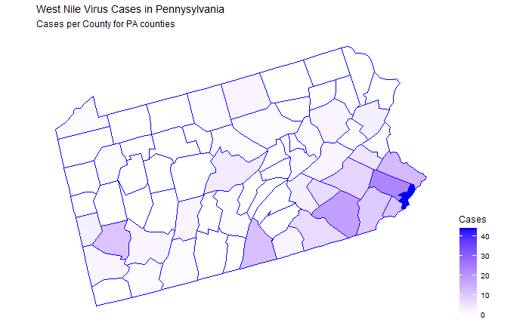
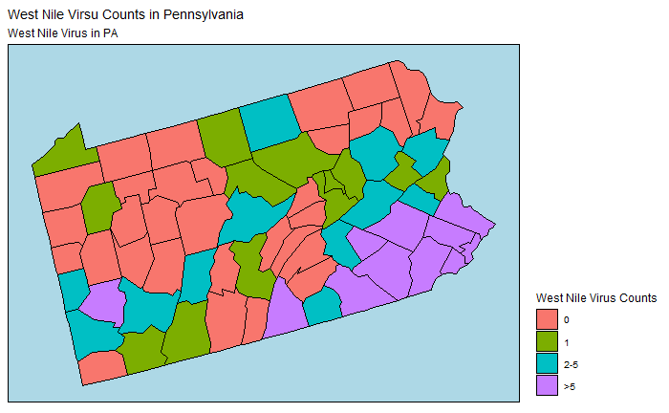
West Nile Virus – Pennsylvania Counties (OA)

Slide 8
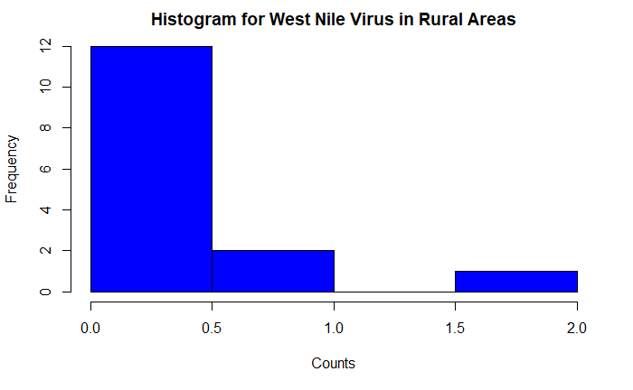
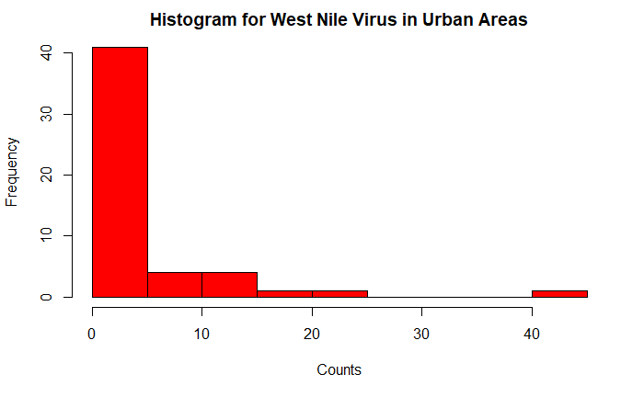
Distribution of West Nile Virus by Rurality/Urbanicity (OA)

Slide 9
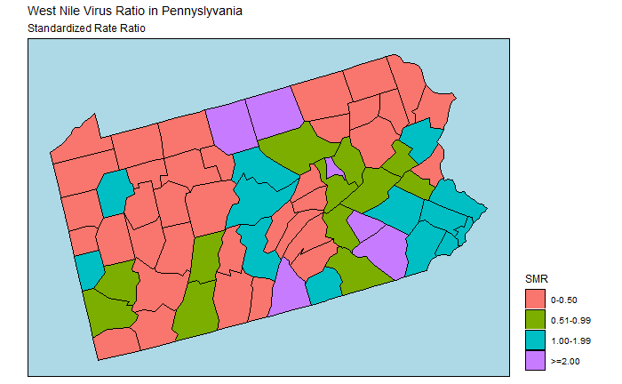
Map of Standardized Ratios: West Nile Virus (OA)

Slide 10
Breakout Room - First Session - 20 Minutes
Covid-19 data: Data File Name: dataCovid_PA.csv
Please prepare choropleth maps of Total_Deaths (column AH) and Poverty (AJ)
Compute and map Standardized Mortality Ratios

Slide 11
Count/Rate Regressions
For aggregated counts data, the most commonly used spatial regressions are based on Poisson and Negative Binomial distributions.
Negative Binomial regression is used when there is overdispersion in the data.
To run a regression with spatial random effects, often a simple county-specific random intercept term that follows a zero-mean Gaussian distribution with a spatial correlation is assumed.
Models can be modified to incorporate space-time dependencies when data come with labels of space and time.

Slide 12
Bayesian Negative Binomial Regression (non-spatial)
Influence is assessed by checking 95% CrI not including zero
The expected rate of West Nile Virus cases among humans is 2.66 (1.3, 5.44) times higher in Metropolitan areas compared to Micropolitan, Rural, and Small Towns, when adjusted for other variables.
For a one percent increase in the rate of less than high school education, the rate of West Nile Virus among humans increased by 1.12 (1.03, 1.22) times.

Slide 13
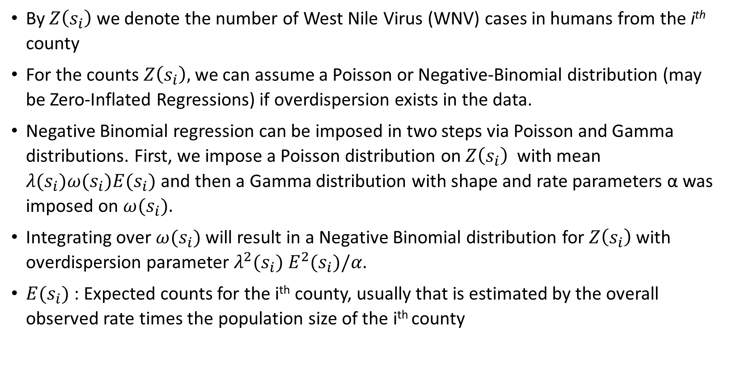
Spatial Regression

Slide 14
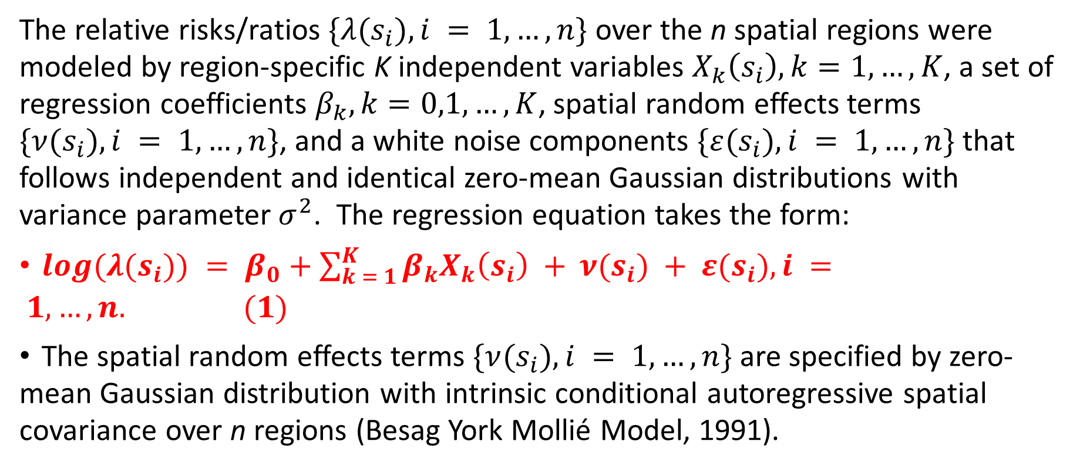
Modeling Risk Ratios

Slide 15
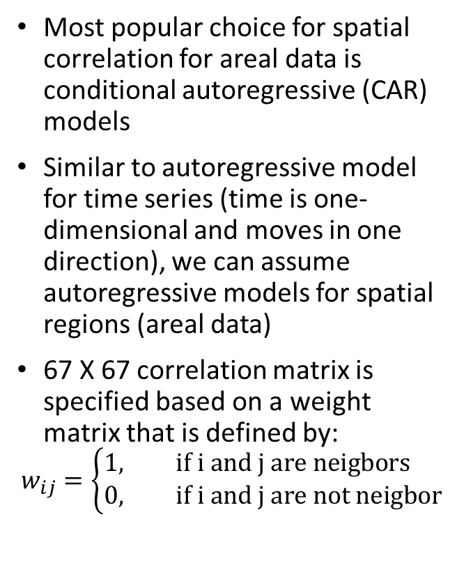
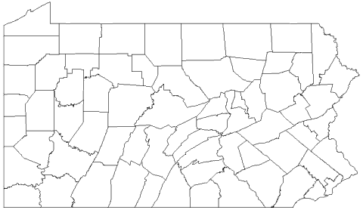
Spatial Correlation for Areal Data

Slide 16
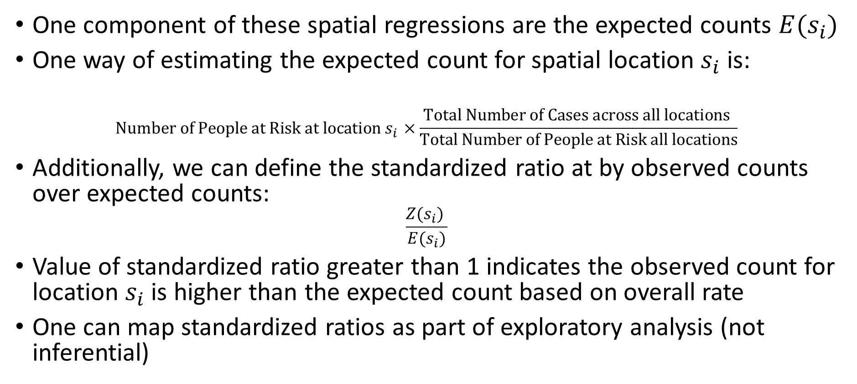
Expected Counts and Standardized Ratios

Slide 17
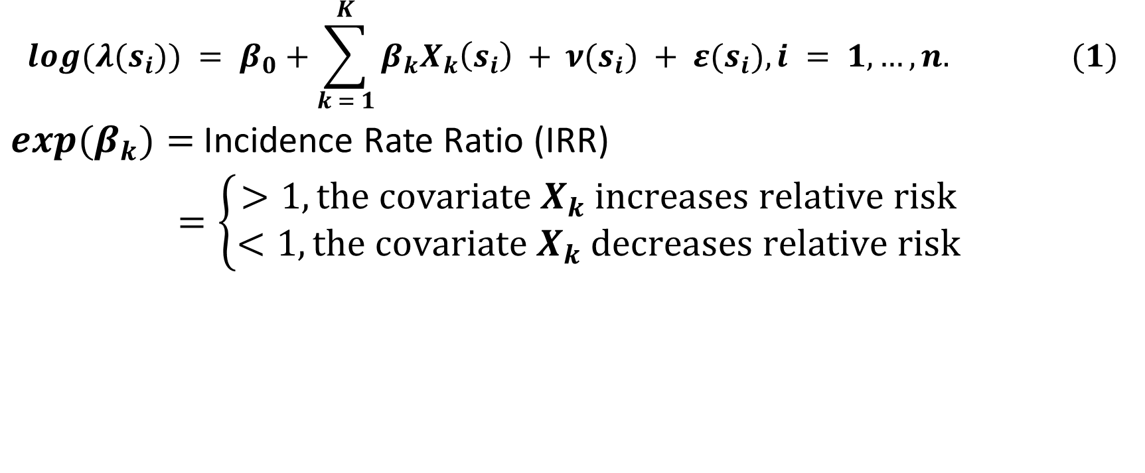
Incidence Risk Ratios and Effects of Covariates

Slide 18
Interpretation of IRR: 95% Credible Intervals
If we fit models in Bayesian paradigm imposing prior distributions on unknown parameters, we can obtain 95% Credible Intervals for IRR
We will avoid the word “significant”
Bayesian analogue of p-value can be computed using the posterior distribution of IRR: P(IRR ∈ [- ε, ε]), for some predefined value of ε
Alternatively, one can examine the inclusion of zero in the 95% Credible Intervals to assess influence of a particular covariate
Interpretation of IRR: The rate of a particular group is IRR times more than the overall rate compared to the baseline group
or: The rate of a particular group increased by IRR times the overall rate for one unit increase in the continuous covariate

Slide 19
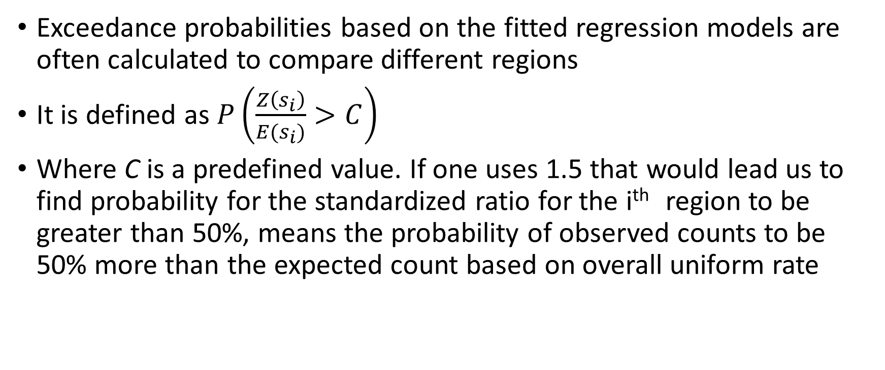
Exceedance Probability

Slide 20
IRR Table Spatial Regression
Influence is assessed by checking 95% CrI not including zero
The expected rate of West Nile Virus cases among humans is 2.66 (1.29, 5.44) times higher in Metropolitan areas compared to Micropolitan, Rural, and Small Towns, when adjusted for other variables.
For a one percent increase in the rate of less than high school education, the rate of West Nile Virus among humans increased by 1.12 (1.03, 1.22) times.

Slide 21
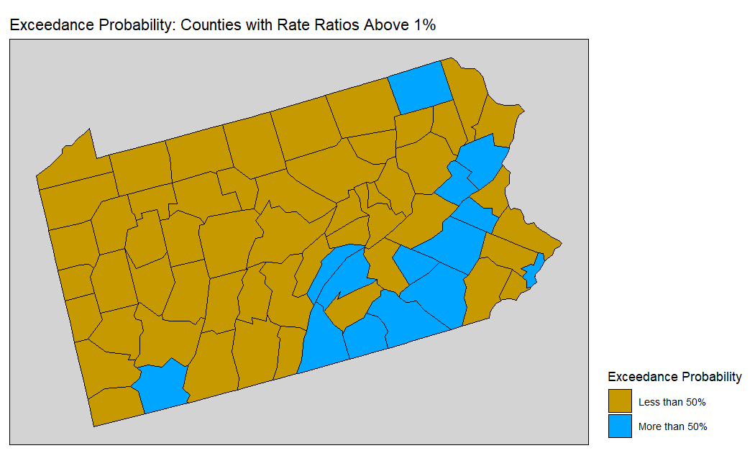
Interpretation of Exceedance Probability

Slide 22
Assessing the need for spatial estimator
Akaike Information Criteria: Lower is better
Bayesian Information Criteria: Lower is better
Deviance Information Criteria: Lower is better
Moran’s I:
Ranges from -1 to +1
0 = no spatial autocorrelation, -1 / +1: negative/positive autocorrelation
assessed using the residuals of the model
neighborhood matrix needed for its computation
assess the absolute value of Moran’s I (values of 0.2 and higher is decent) and the p-value (p<0.05 is significant) in making a decision

Slide 23
Spatial Analysis using R-INLA
Dr. Oluwaseun Adeyemi’s R Tutorial

Slide 24
Breakout Room - Session 2 (20 Minutes)
Run the spatial regression on COVID-19 data using:
Outcome: Deaths across 67 counties over t = 10 months, Jan 2020 – October 2020, Total_Deaths
Independent Variables (2020 Estimated Rates)
% of Black Population (Black_Percent, column AK)
% of population above 65 years (years65, column AL)
% in Poverty (Poverty, column AJ)
% Having Some College or Associate Degree (somecollegeassociate, AN)
% Obese (Obesity, column AQ)
Metropolitan (Yes/No) (column AS)

Slide 25
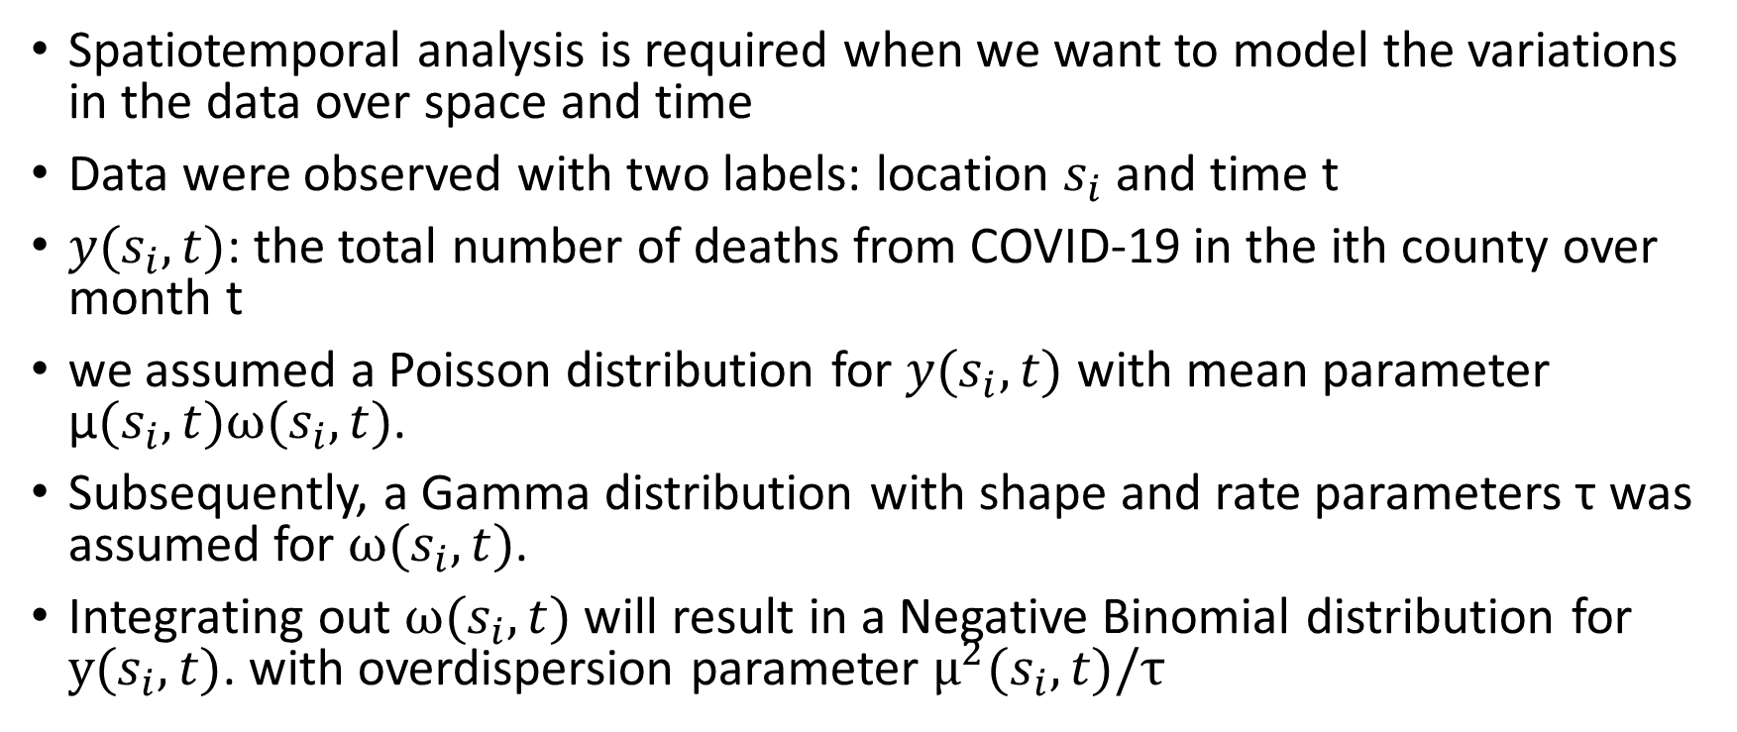
Spatiotemporal Analysis using R-INLA

Slide 26
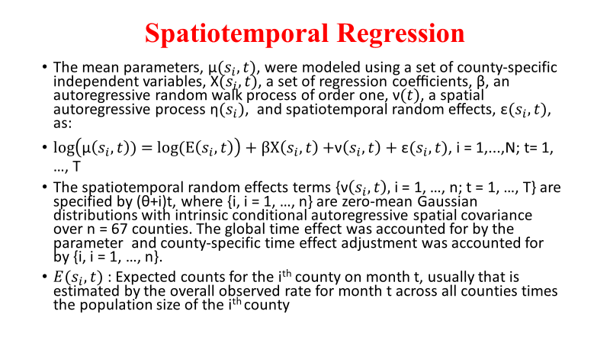
Spatiotemporal Regression

Slide 27
Interpretation of IRR: 95% Credible Intervals: COVID-19 Example
Variables | Unadjusted |  | Adjusted
 | Rural | Urban | Rural | Urban
Neighborhood and Built Environment
Percent Severe Housing Cost Burden | 1.13 (1.10, 1.17) | 1.18 (1.14, 1.21) | − | −
Residential Segregation Index | 1.01 (1.01, 1.02) | 1.03 (1.02, 1.04) | 1.01 (1.00, 1.01) | 1.03 (1.02, 1.04)
Economic Stability
Percent Unemployed | 1.41 (1.30, 1.53) | 1.69 (1.54, 1.86) | 1.08 (0.97, 1.20) | 1.41 (1.24, 1.60)
Percent Uninsured | 1.32 (1.30, 1.35) | 1.34 (1.30, 1.37) | 1.22 (1.18, 1.26) | 1.09 (1.04, 1.13)
Income Inequality Ratio | 1.01 (1.01, 1.01) | 1.01 (1.01, 1.01) | 1.00 (1.00, 1.00) | 1.00 (1.00, 1.00)
Education
Percent Some College or Associate Degree | 0.79 (0.78, 0.81) | 0.78 (0.76, 0.80) | 0.92 (0.90, 0.95) | 0.80 (0.77, 0.83)
Social and Community Context
Percent Black Population | 1.11 (1.10, 1.12) | 1.10 (1.08, 1.11) | 1.07 (1.06, 1.08) | 1.05 (1.04, 1.07)
Percent 65 Years and Above | 0.91 (0.89, 0.93) | 0.92 (0.90, 0.95) | 0.95 (0.92, 0.98) | 1.03 (0.98, 1.07)
Percent Female Population | 1.19 (1.14, 1.26) | 1.20 (1.14, 1.26) | 1.17 (1.11, 1.24) | 1.3 (1.22, 1.38)
Health and Health Care
Percent Frequent Mental Distress | 1.26 (1.17, 1.34) | 1.32 (1.22, 1.42) | − | −
Percent Frequent Physical Distress | 1.21 (1.17, 1.34) | 1.31 (1.22, 1.40) | − | −
Percent Diabetes | 1.09 (1.06, 1.12) | 1.13 (1.09, 1.17) | 1.09 (1.06, 1.13) | 1.06 (1.01, 1.11)
HIV Rate per Million | 1.12 (1.11, 1.13) | 1.05 (1.04, 1.06) | 1.02 (1.01, 1.03) | 1.01 (1.00, 1.02)
Percent Adult Smoker | 1.10 (1.06, 1.14) | 1.14 (1.09, 1.18) | − | −
Percent Obesity | 1.17 (1.15, 1.20) | 1.18 (1.15, 1.20) | − | −
Paul, R., Adeyemi, O., Ghosh, S., Pokhrel, K., & Arif, A. A. (2021). Dynamics of Covid-19 mortality and social determinants of health: a spatiotemporal analysis of exceedance probabilities. Annals of epidemiology, 62, 51-58.

Slide 28
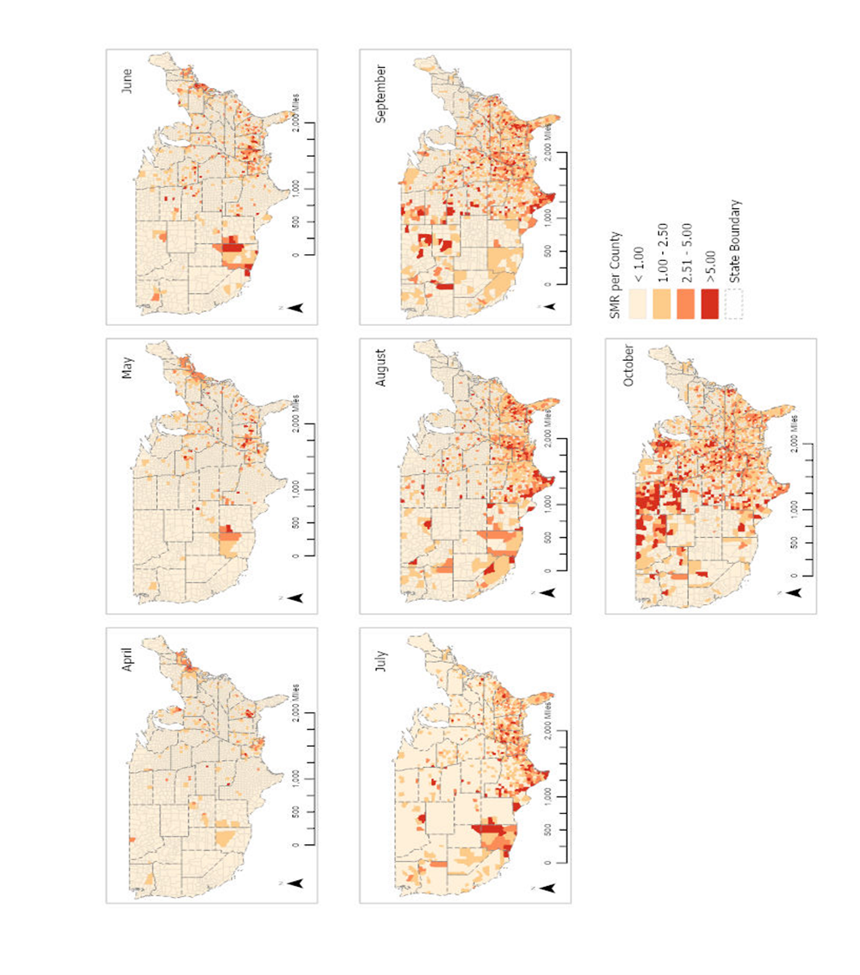
Map of Standardized Ratios: Deaths from COVID-19
Paul, R., Adeyemi, O., Ghosh, S., Pokhrel, K., & Arif, A. A. (2021). Dynamics of Covid-19 mortality and social determinants of health: a spatiotemporal analysis of exceedance probabilities. Annals of epidemiology, 62, 51-58.

Slide 29
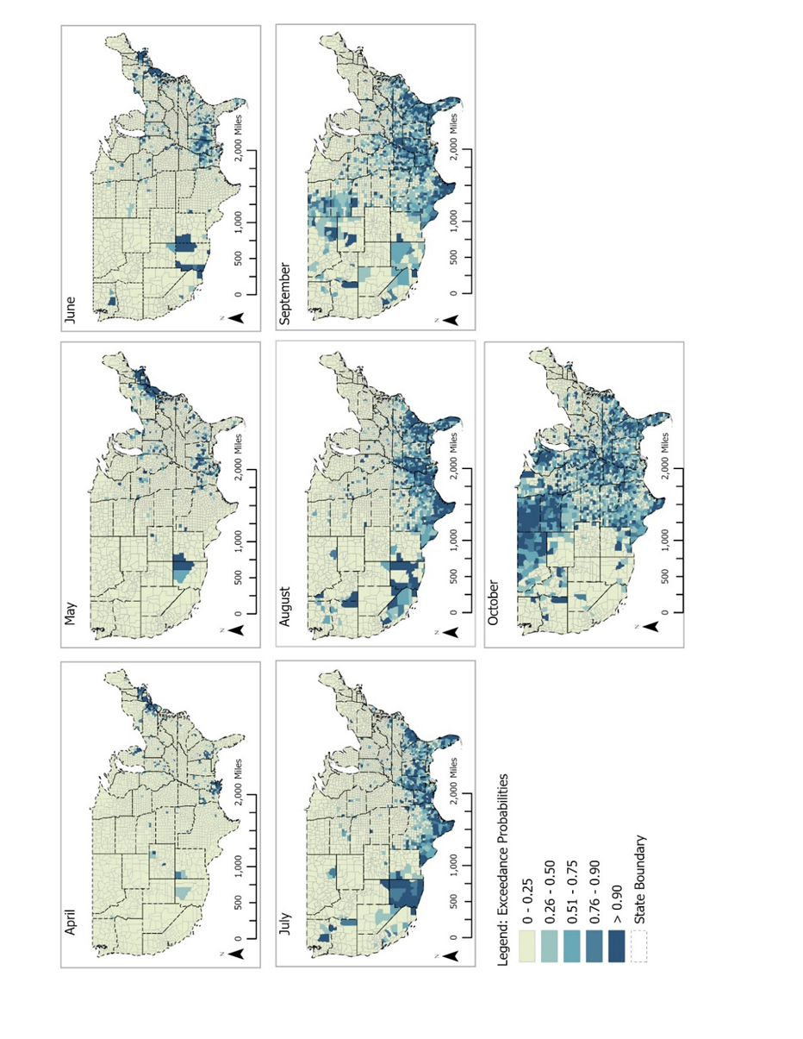
Exceedance Probability: COVID-19 Example
Paul, R., Adeyemi, O., Ghosh, S., Pokhrel, K., & Arif, A. A. (2021). Dynamics of Covid-19 mortality and social determinants of health: a spatiotemporal analysis of exceedance probabilities. Annals of epidemiology, 62, 51-58.

Slide 30
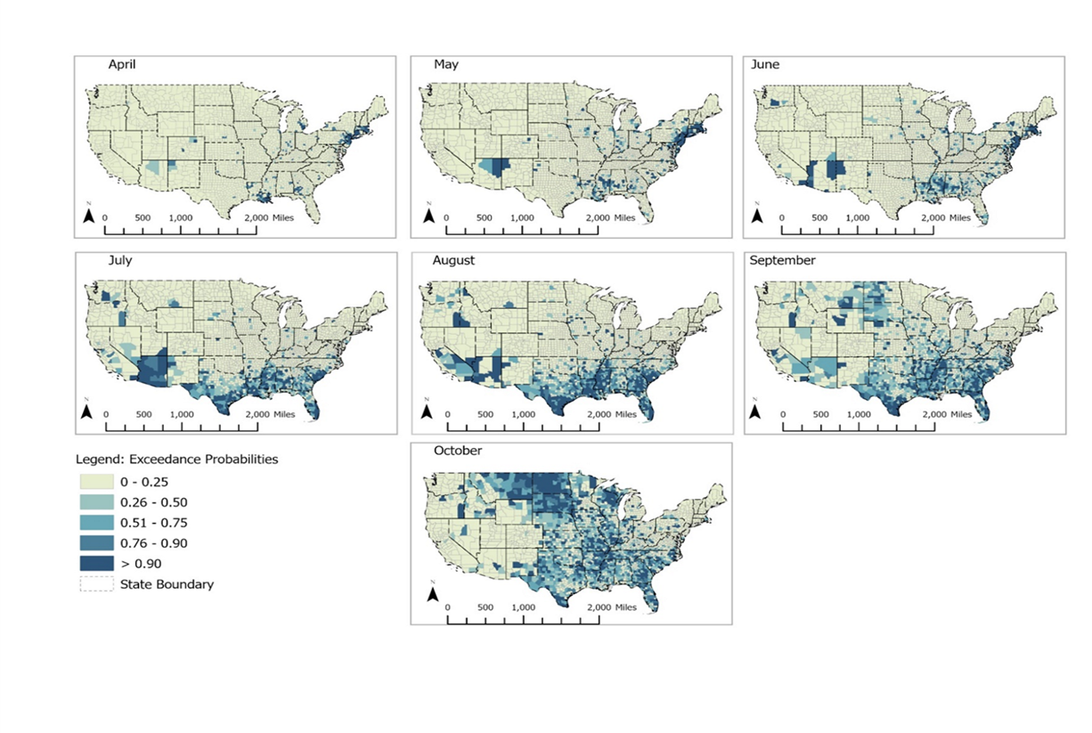
Exploratory vs. Model Based Approaches
Data: SMR - Exploratory Analysis
Exceedance Probabilities: Modeling Based Approach

Slide 31
COVID-19 data from PA: Spatiotemporal Regression
Outcome: Deaths across 67 counties over t = 7 months, April 2020 – October 2020
Independent Variables (2020 Estimated Rates)
% of Black Population
% of population above 65 years
% in Poverty
% Having Some College or Associate Degree
% Obese
Metropolitan (Yes/No)

Slide 32
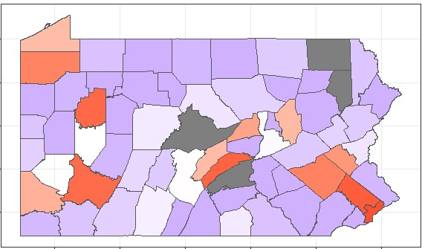
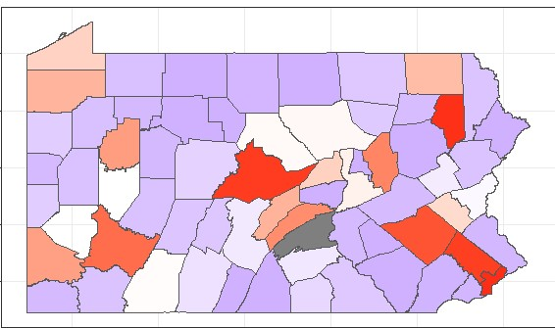
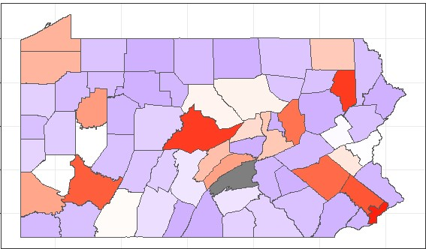
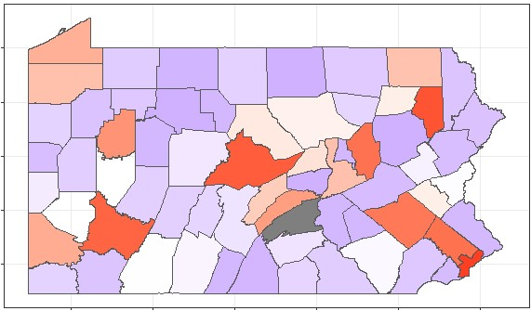
COVID-19 data from PA: Standardized Mortality Ratios (Map: Seun)
April 2020
May 2020
June 2020
July 2020
August 2020

Slide 33
Spatiotemporal Analysis using R-INLA
Dr. Oluwaseun Adeyemi’s R Tutorial

Slide 34
Final Remarks
•Spatial and spatiotemporal analysis can be broadly classified into three categories
-Geostatistical Analysis: when analyses were done on coordinates, like latitude and longitude, for example, climate models
-Methods for Lattice Data – most popular in health studies, aggregated data over census tracts, zip codes, and counties
-Point Processes – when locations of occurrences of disease become random variable and outcome of interest – diseased trees in a forest, T cell growth in colorectal cancer
• Many modeling options exist based on types of data and spatial/spatiotemporal correlations – large data, underreported data, skewed data, categorical data, censored data,zero-inflated data, measurement errors in independent variables, etc.

Slide 35
References
Besag, J., York, J., & Mollié, A. (1991). Bayesian image restoration, with two applications in spatial statistics. Annals of the institute of statistical mathematics, 43(1), 1-20.
de Oliveira, G. L., Argiento, R., Loschi, R. H., Assunçao, R. M., Ruggeri, F., & Branco, M. D. E. (2022). Bias correction in clustered underreported data. Bayesian Analysis, 17(1), 95-126.
Khana, D., Rossen, L. M., Hedegaard, H., & Warner, M. (2018). A Bayesian spatial and temporal modeling approach to mapping geographic variation in mortality rates for subnational areas with R-INLA. Journal of data science: JDS, 16(1), 147.
Paul, R., Adeyemi, O., Ghosh, S., Pokhrel, K., & Arif, A. A. (2021). Dynamics of Covid-19 mortality and social determinants of health: a spatiotemporal analysis of exceedance probabilities. Annals of epidemiology, 62, 51-58.
Ver Hoef, J. M., Peterson, E. E., Hooten, M. B., Hanks, E. M., & Fortin, M. J. (2018). Spatial autoregressive models for statistical inference from ecological data. Ecological Monographs, 88(1), 36-59.
Virgilio Gómez-Rubio (2021): Bayesian Inference with INLA: https://becarioprecario.bitbucket.io/inla-gitbook/index.html

Slide 36
Thank You!

